Slide 1


Slide 2

Problem Statement:
AtliQ Grands, with 2 decades in India's hospitality sector faces market share and revenue challenges in luxury/business hotels due to competition and management decisions, aiming for a resurgence.
The management team notice this problem and hired a group of data analyst to give them data driven insights so that they can take better decision.

Slide 3
AtliQ Grands Hotels :
Category
Luxury
business
Property name
Property name
AtliQ Grands
AtliQ Exotica
AtliQ City
AtliQ Palace
AtliQ Blu
AtliQ Bay
AtliQ Seasons
Standard
Every Property Room has 4 class
Elite
Premium
Presidential

Slide 4
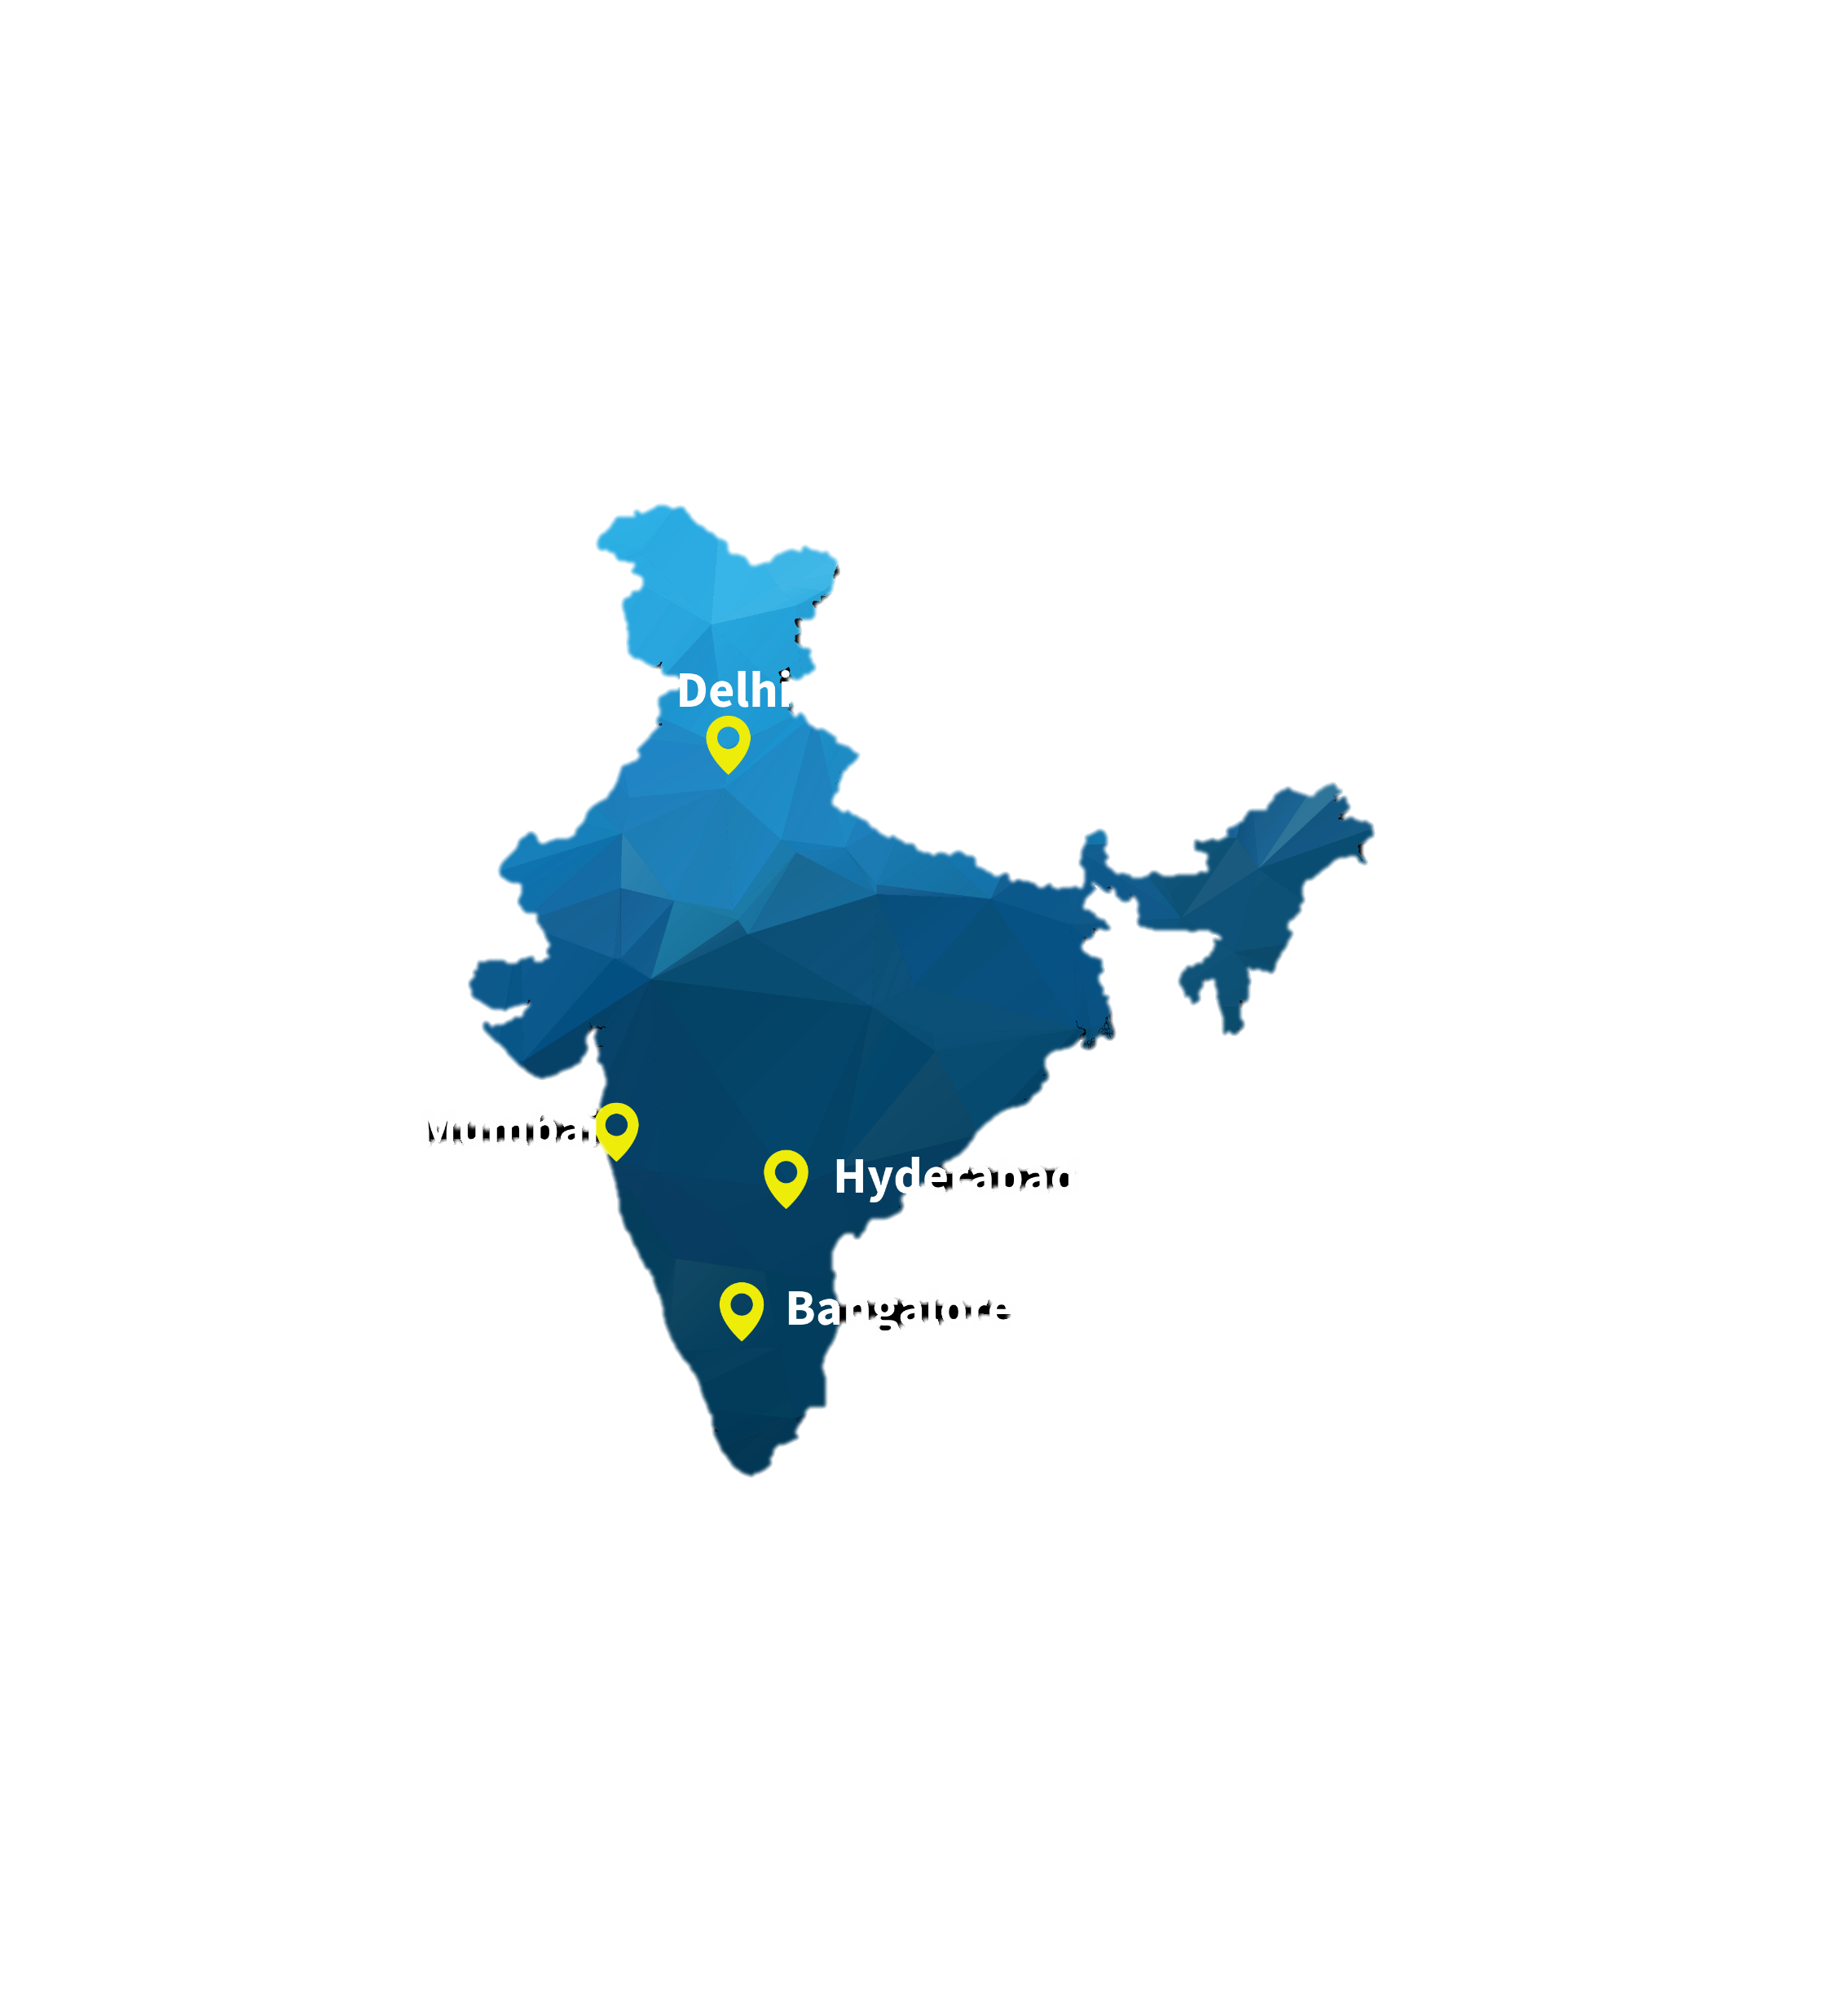
Target Cities

Slide 5
Key Metrics:-
1. Total Available Rooms - Total number of rooms – Number of rooms out of order/not in service/out of inventory
2. RevPar(Revenue per Available Room ) - Total Room Revenue / Total Rooms Available
3. Average Daily Rate(ADR) - Rooms Revenue / Paid Rooms Occupied
4. Occupancy % - Paid Rooms Occupied / Rooms Available
OR RevPar/ ADR
5. RevPar = Occupancy % * ADR therefore we can say RevPar <= ADR
6. SRN (Sellable room Nights) – Days * Total Available Rooms
7. DSRN (Daily Sellable room Nights ) - Total Available Rooms
8. URN (Utilized Room Nights) – customer stayed or Customer who checked out
7. BRN – Total Bookings(customer stayed + No show + Cancelled)
8. Realization – URN / BRN

